Slide 1

Insights for the clinical diagnostics market
Webinar
COVID-19 Business Impact
on Clinical Diagnostics
April 30, 2020
covid19@kaloramainformation.com
© 2018 IMV, part of the Science and Medicine Group
© 2020 Kalorama Information, part of Science and Medicine Group
Kalorama Information
671 North Glebe Road
Suite 1610
Arlington, VA 22203
www.kaloramainformation.com

Slide 2



Today’s Presenters
Bruce Carlson
SVP Publishing
Doreen Pippen
VP Insights
Craig Overpeck
CEO

Slide 3





Our Global Insights Brands are Leaders in
Instrumentation, Life Science, Imaging, and Clinical Diagnostics

Slide 4

Clinical Diagnostics Tracker Methodology
Survey conducted in US
every other week
Except in COVID Hot Spots
Survey available to respondents for one week, each wave
Data included in Tableau file with filters by key demographics

Slide 5
Demographics

Slide 6
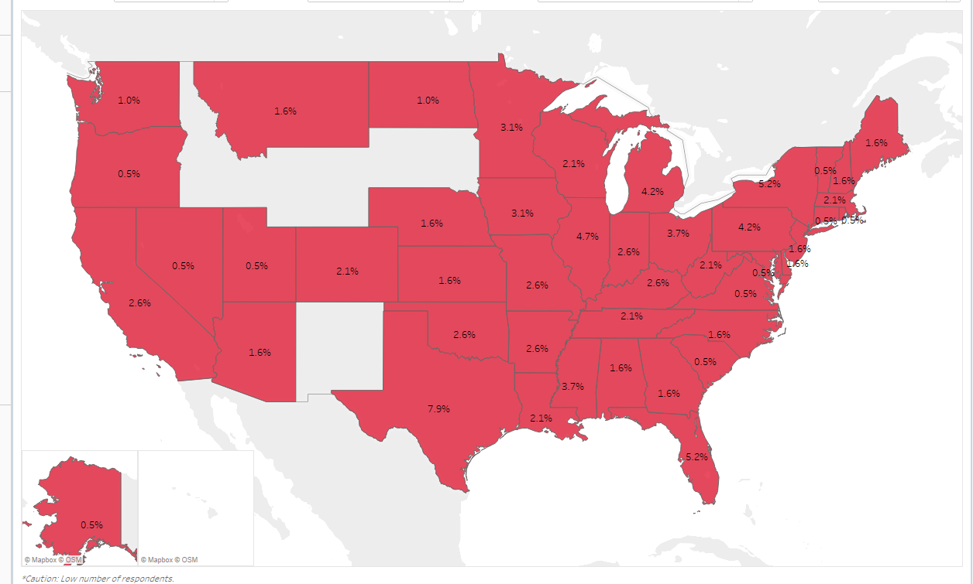
Regional Distribution
n=191 (Wave 1)

Slide 7
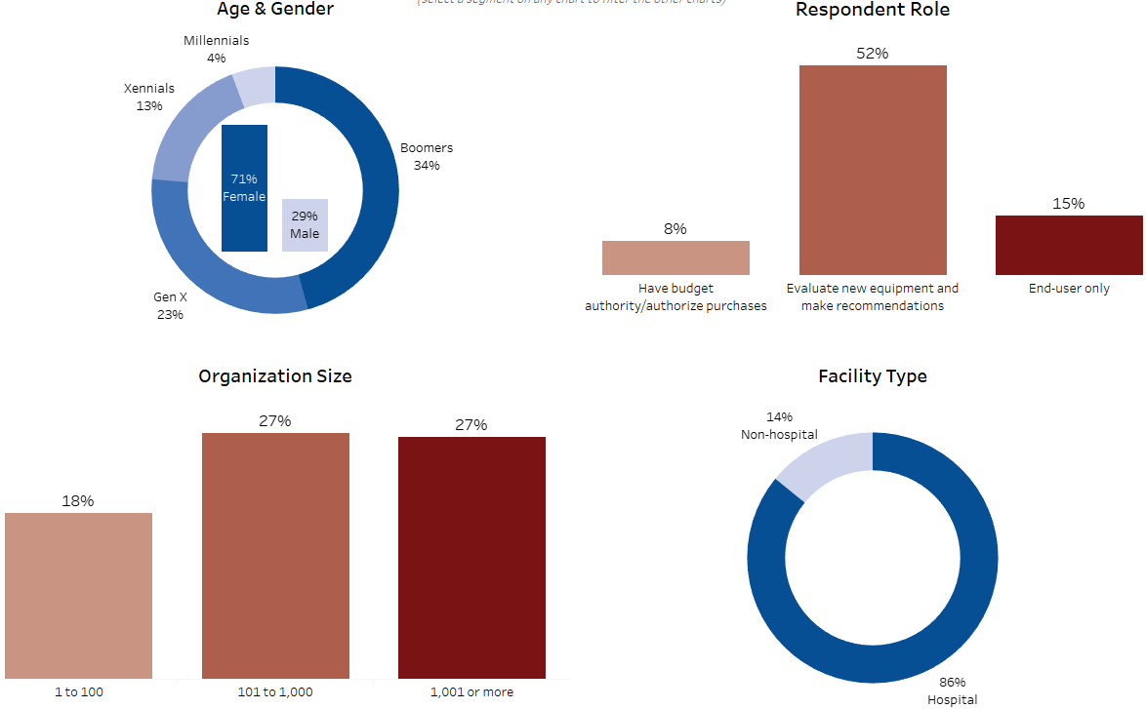
Additional Demographics – Available Filters in Report
n=191 (Wave 1)

Slide 8
Department Disruption

Slide 9
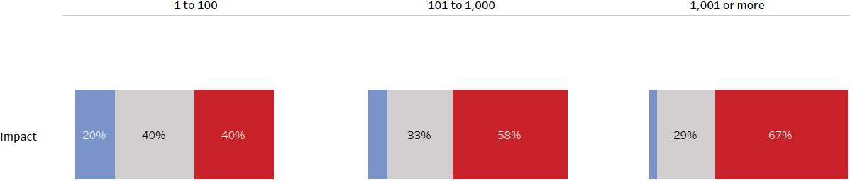

Larger Institutions More Impacted
Overall Impact of COVID-19 Pandemic on Department by Facility Size (# of employees)
n=191 (Wave 1)
How much of an IMPACT is the current coronavirus pandemic having on your lab? (choose only one)

Slide 10
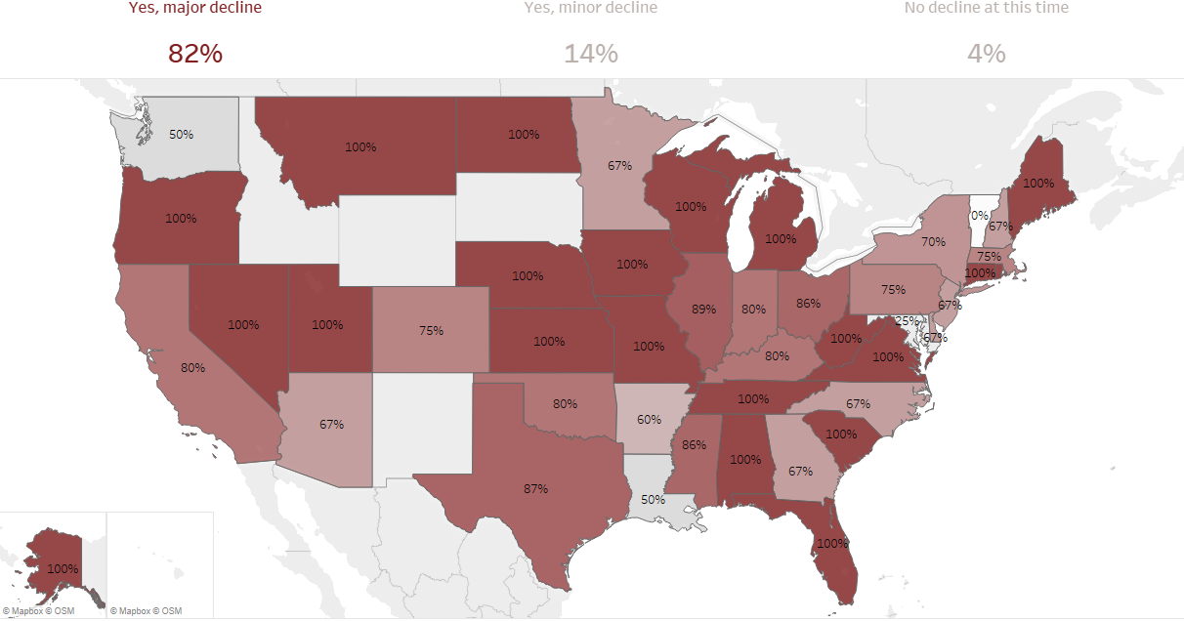
Impact on Clinical Diagnostics Facilities (4/10/20-4/27/20)
Map depicts % of facilities reporting a Major Decline
n=191 (Wave 1)
Is your lab experiencing a decline in non-coronavirus test volume due to COVID-19?

Slide 11
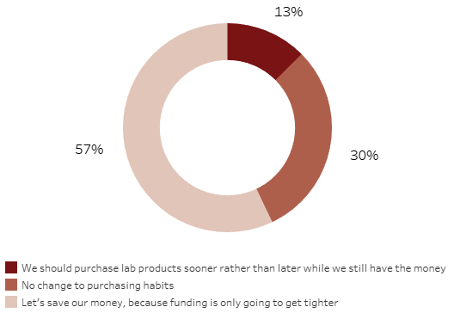
Majority Reducing Budget and Purchases, Some Labs Buying
Perspective on Stability of 2020 Budget
Which of the following statements best reflects the collective perspective of your lab (department) with respect to the stability of your 2020 budget? (choose only one)
n=191 (Wave 1)

Slide 12
Areas of Concern

Slide 13
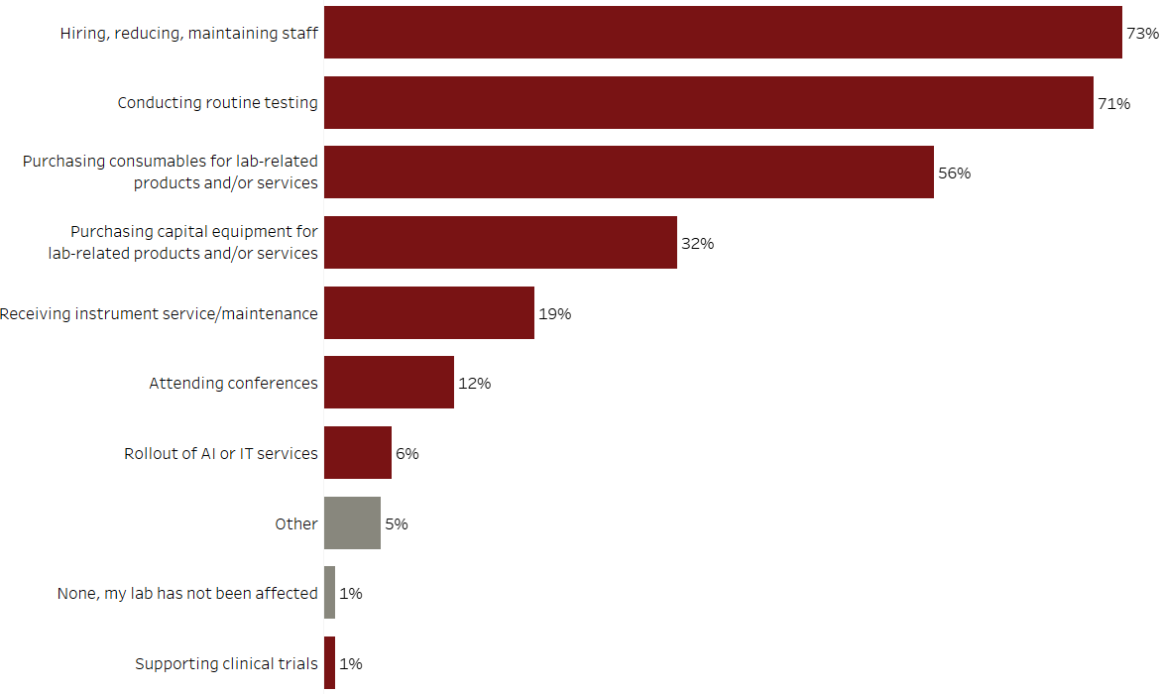
Concerns: Staff and Routine Testing Drop Rate High
Areas Most Affected by Current Pandemic and Economic Climate
n=191 (Wave 1)
In your lab (department), what THREE areas are most affected by the current pandemic and economic climate? (check no more than three)

Slide 14
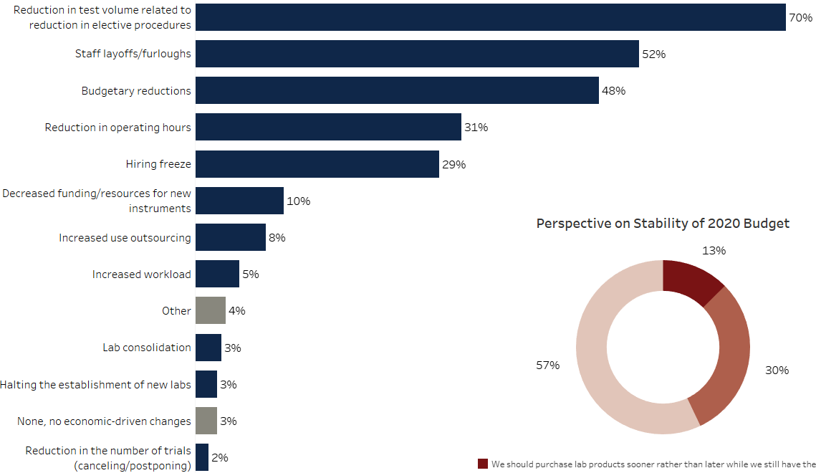
Economic Impact on Labs: Concern About Layoffs, Hiring
Top Economic-Driven Changes in Organization
n=191 (Wave 1)
What are the top THREE economic-driven changes currently happening at your organization/institution? (check up to three)

Slide 15
Impact by Type of Test

Slide 16
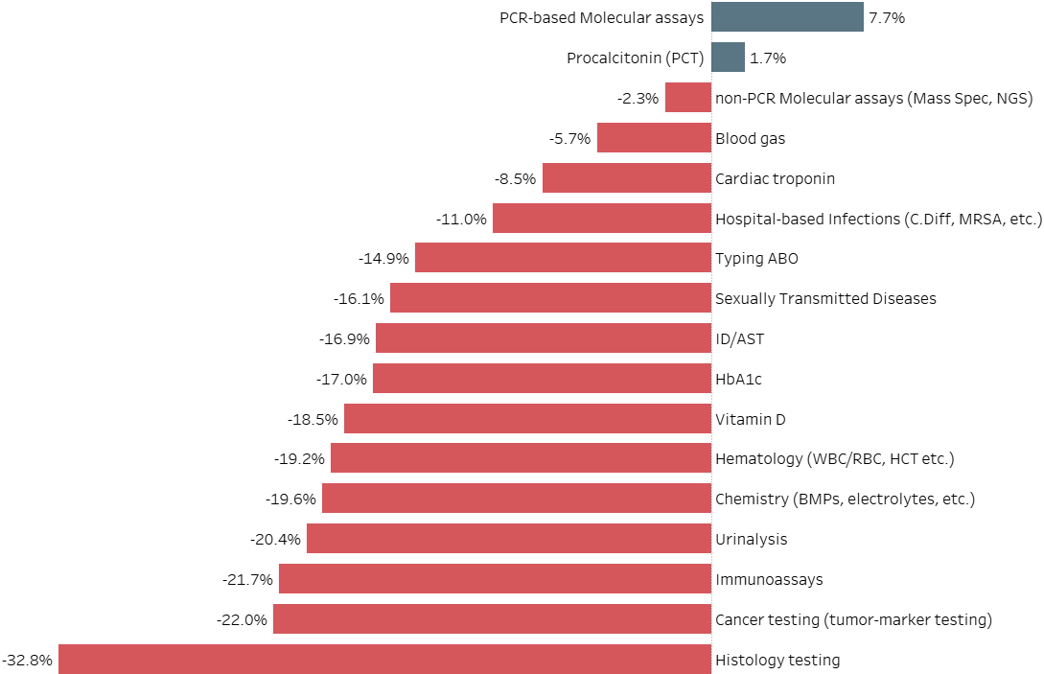
Testing Areas Impacted by COVID-19
Average Impact on Test Volume
n=157 (Wave 1)
For each of the following tests/modalities how has your test volume been impacted due to coronavirus? (choose one for each)

Slide 17
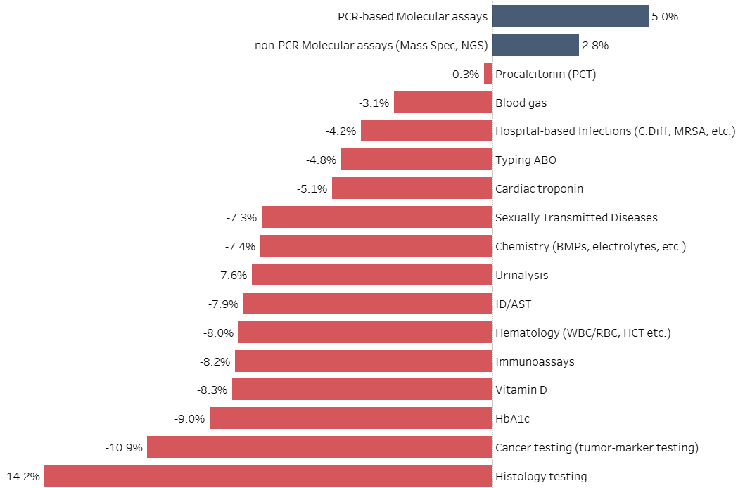
Budget Changes Expected in 2020
Average Expected Change in Spending on Products in 2020
Compared to your annual budget, how do you expect the average amount of money that your lab (department) spends on products purchased in each of the following categories to change in 2020 (choose only one or each)
n=129 (Wave 1)

Slide 18
How long until we get back to normal?

Slide 19
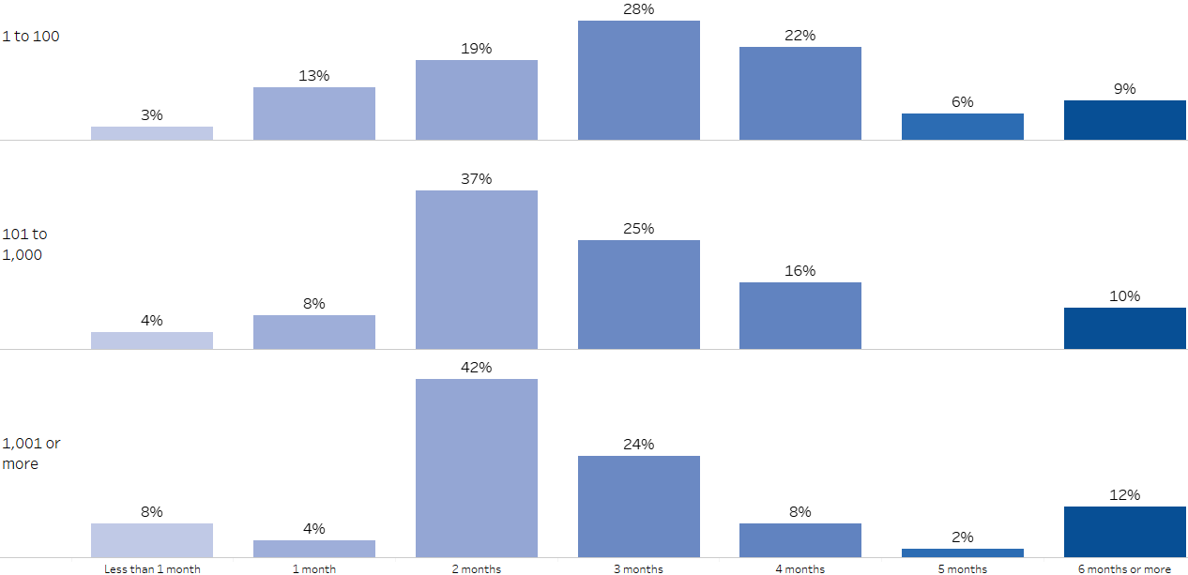
Ramp up from 2-4 months but depends on site of institution
Larger Institutions more impacted but faster to recover
Anticipated Ramp-Up Time Once Labs Re-Open by Facility Size (# of employees)
n=184 (Wave 1)
How long do you anticipate that it will take your lab to ramp back-up to previous volume levels? (choose only one)

Slide 20
Questions?
Q&A

Slide 21
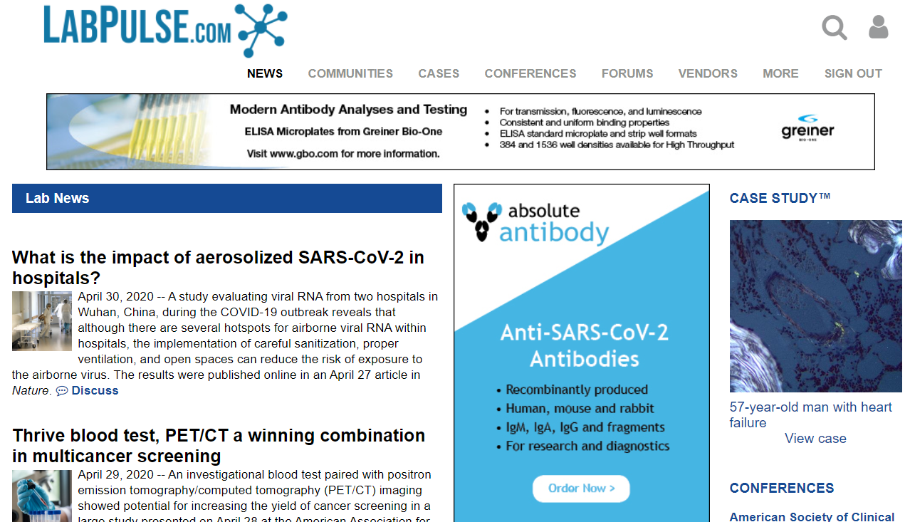
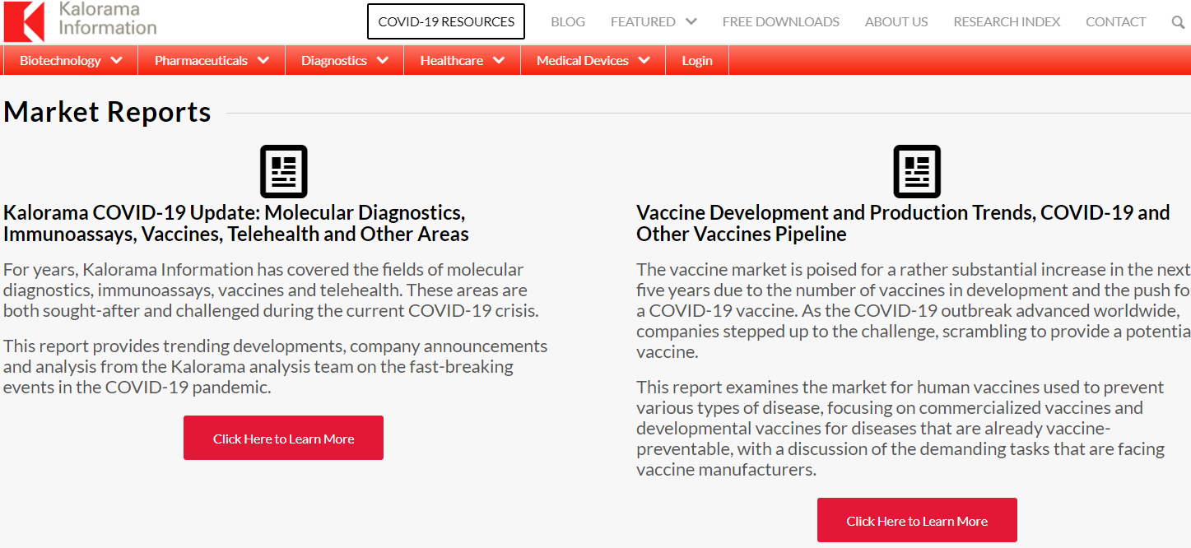
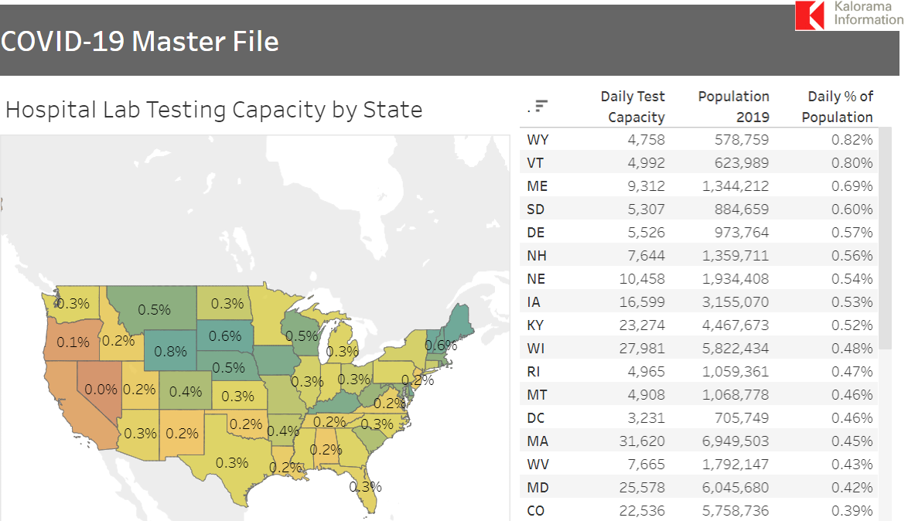
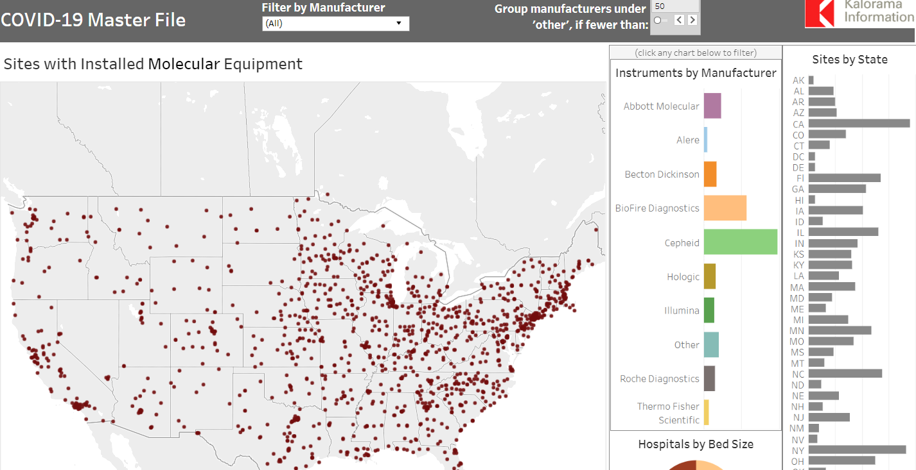
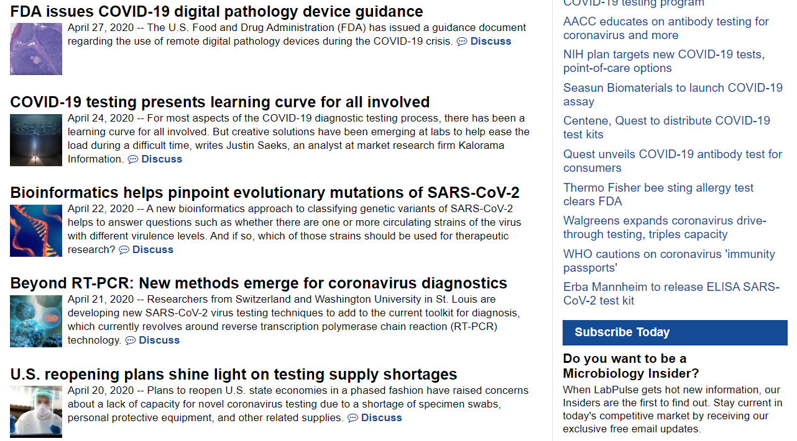
COVID-19 Resources
COVID19@KaloramaInformation.com

Slide 22
Please email COVID19@KaloramaInformation.com to receive the slide deck or for information about how to purchase the ongoing tracking data
THANK YOU

